Slide 1
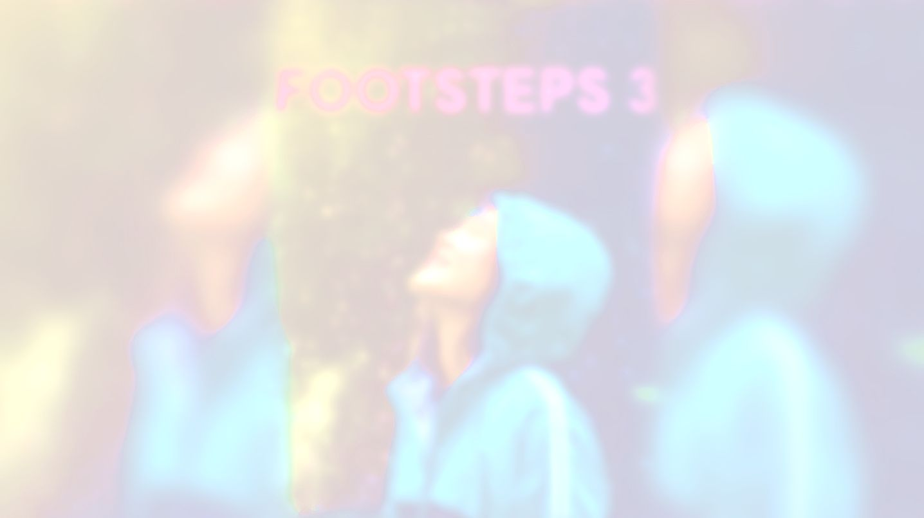


UNIT 5;
It takes drive
Instahappiness

Slide 2
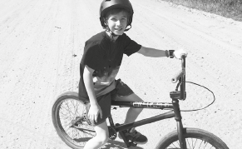

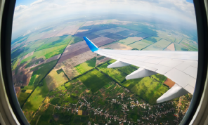
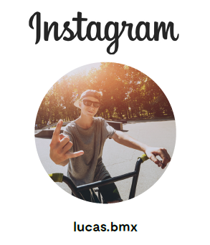
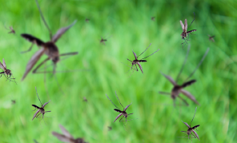
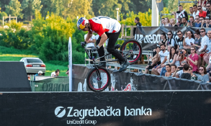
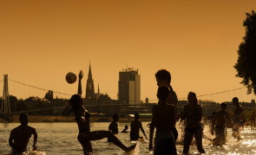
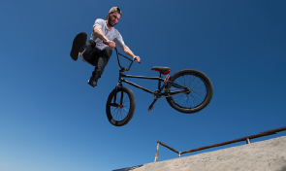


Slide 3
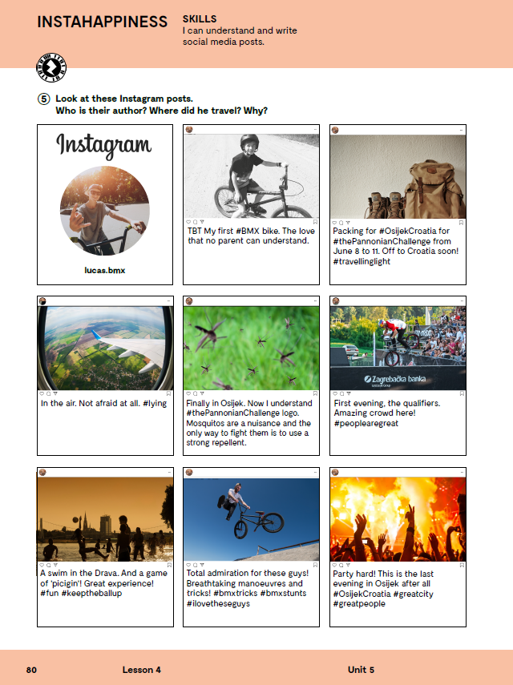
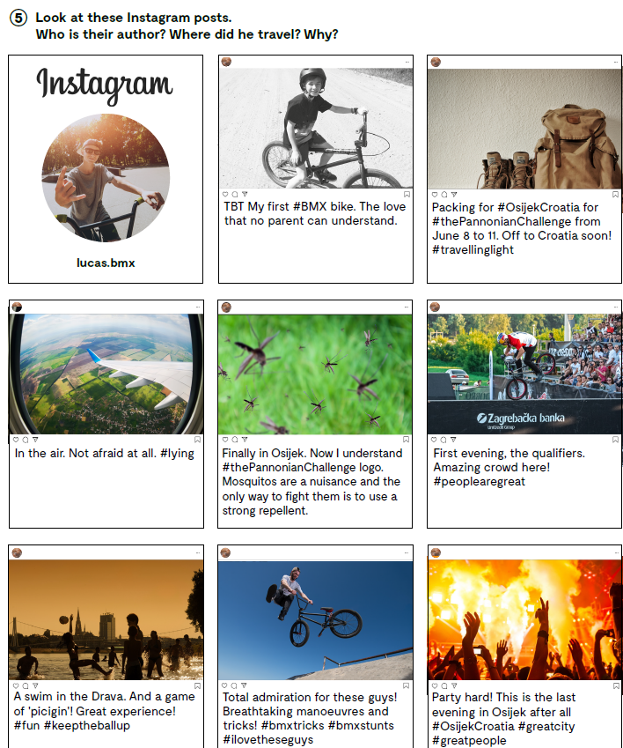

Slide 4
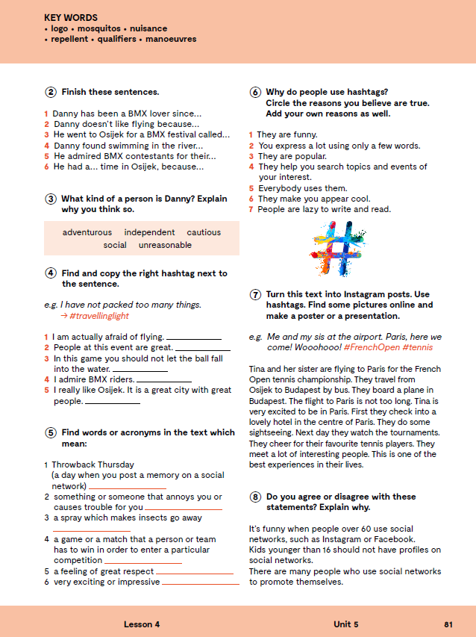
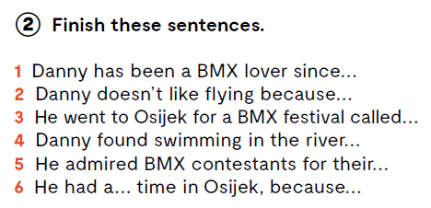
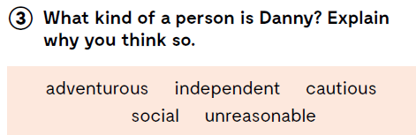
1 Danny has been a BMX lover since he was a
child.
2 Danny doesn't like flying because he is afraid
of heights.
3 He went to Osijek for a BMX festival called
The Pannonian Challenge.
4 Danny found swimming in the river a great
experience.
5 He admired BMX contestants for their
manoeuvres and tricks.
6 He had a great time in Osijek because the
city and people were great.

Slide 5
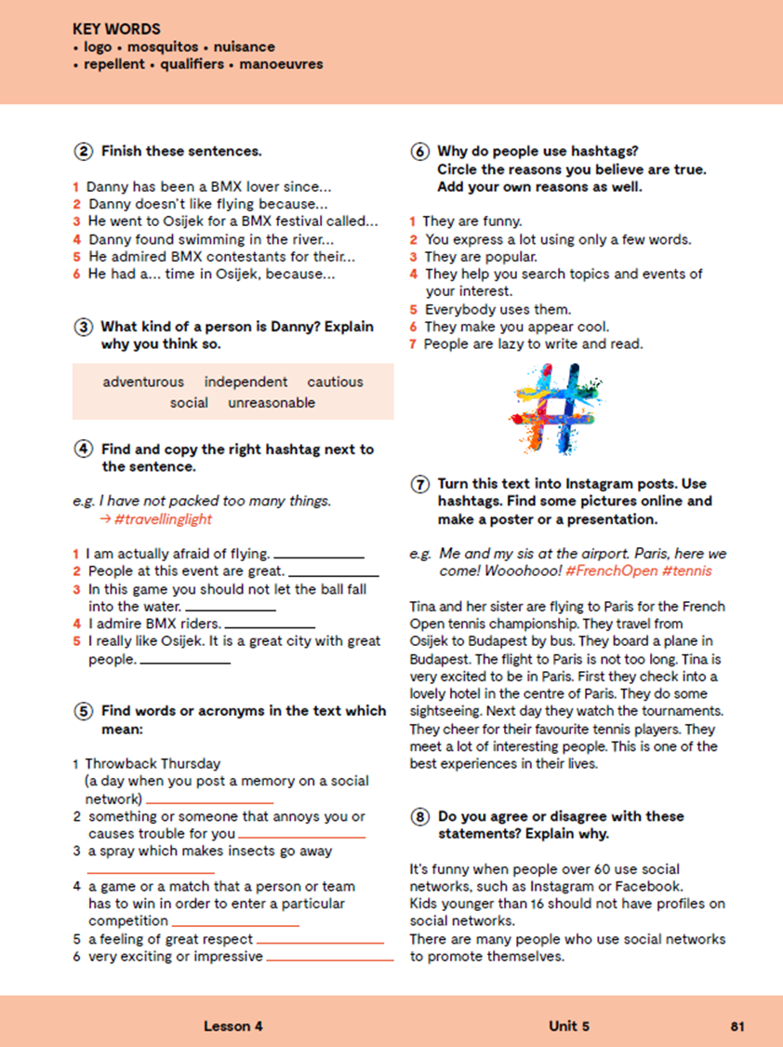
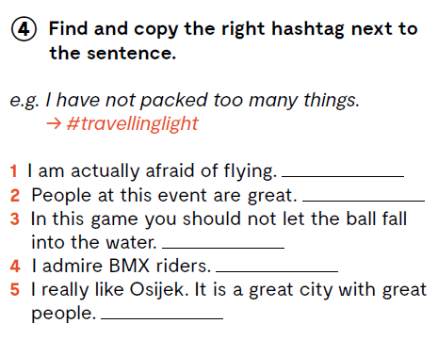
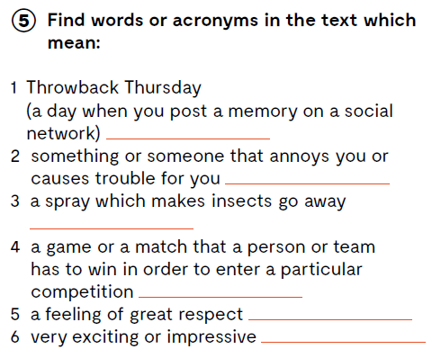
#lying
#peoplearegreat
TBT
#keeptheballup
a nuisance
#ilovetheseguys
a reppelent
#OsijekCroatia #greatcity #greatpeople
the qualifiers
admiration
Let’s practise:
https://wordwall.net/play/847/287/441
breathtaking

Slide 6
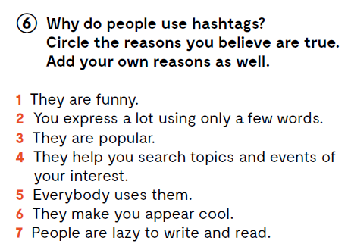

Slide 7
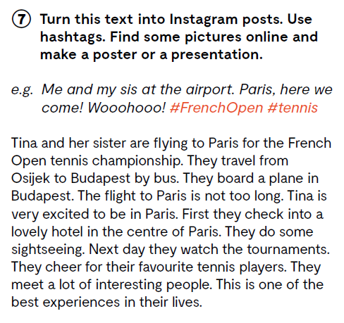
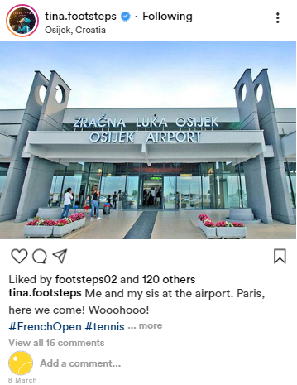
https://zeoob.com/generate-instagram-post/

Slide 8
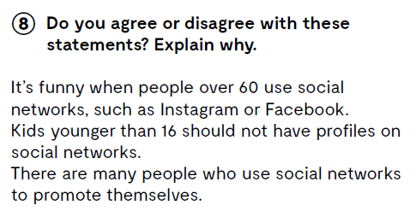

Slide 9
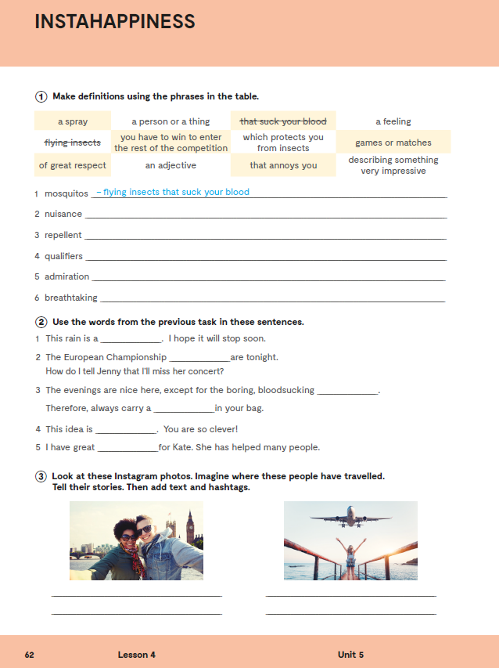
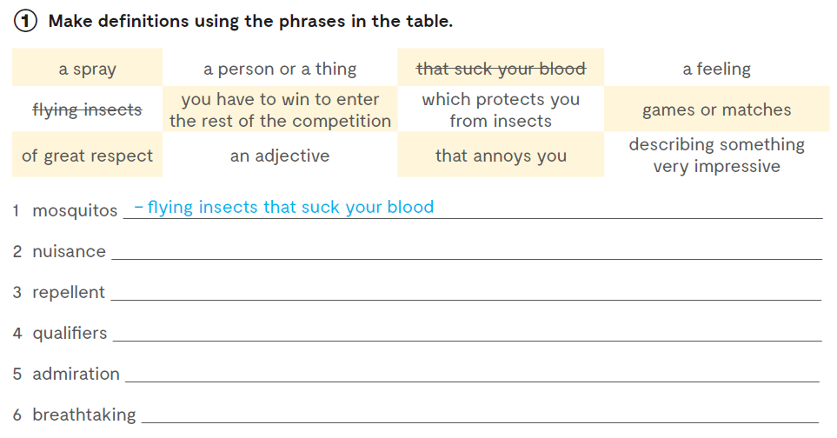
Workbook, p. 62
- a person or a thing that annoys you
- a spray which protects you from insects
- games or matches you have to win to enter the rest of the competition
- a feeling of great respect
- an adjective describing something very impressive

Slide 10
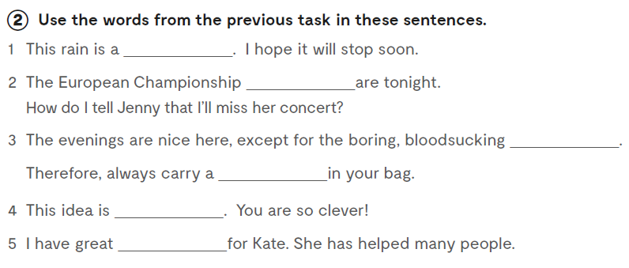
nuisance
qualifiers
mosquitos
repellent
breathtaking
admiration

Slide 11
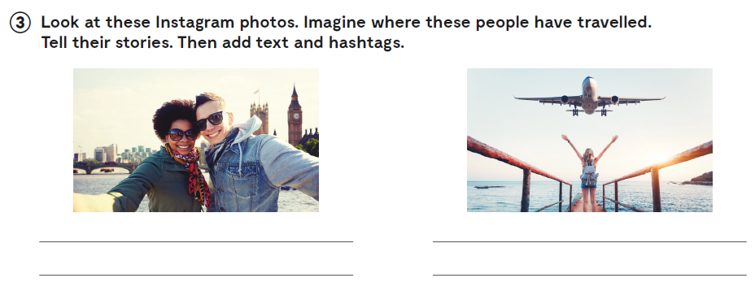

Slide 12

LEARN MORE!
https://www.e-sfera.hr/dodatni-digitalni-sadrzaji/6963fdd4-8880-4608-9e34-3666dc4c470b/
Instagram in numbers (As of February 2020)

